Slide 1
Plant Information Models in Existing UK Nuclear Power Stations
Nuclear Power Plant – Plant Information Map
Investment Proposal & Analysis
Plant Loss -
System Performance
Operators Log
Equipment Monitoring Scada
Capital Investment Programme
Capital Project management
Plant Risk Log
Equipment Reliability
System Performance
MSDS
Bill of Materials
Equipment Classifications
Location Hierarchy
System Hierarchy
PLM 3D Drawings, Design Documentation
Project Actuals
Project Forecast
Materials Catalogue
UTC, Rotating Parts
Equipment Plant Inventory
Condition Reports, Actions
Engineering Design Change
Drawings
Procurement Engineering (equivalent Parts)
General Ledger
Planned & Actual Materials
Work Request
Safety Documents
Document management
Lifetime Records
Invoice Payment
Goods Receipt
Warehouse Stores Movement
Materials/Service Request
Risk Assessment
Isolations & Tag Out
Clearance Order
Records Management
Scanned Documents
Invoice & Lines
Dues In
Requisition & Lines
Preventative Maintenance & Job Plans
Work Orders(Live, models & Complete)
Documents & Drawings
Word Documents, PDF etc.
Service Receipt
Purchase Order & Lines
Vendors / Manufacturers
Work Schedules
Records
Unstructured Documents
Contract Management
Achilles Supplier Database
MS Project / P6 Work Plan (Outage & Work Week)
Person availability
Labour Entry
Contractors
Employee
Roles
Qualifications
Absence
Training Courses
Training catalogue
Annual Leave
Sickness etc.
Operators
System Health
Plant Loss
Investment Management
ECM Content Management
ERP Management
HR system
Work & Asset Management
MS Project / Primavera

Slide 2
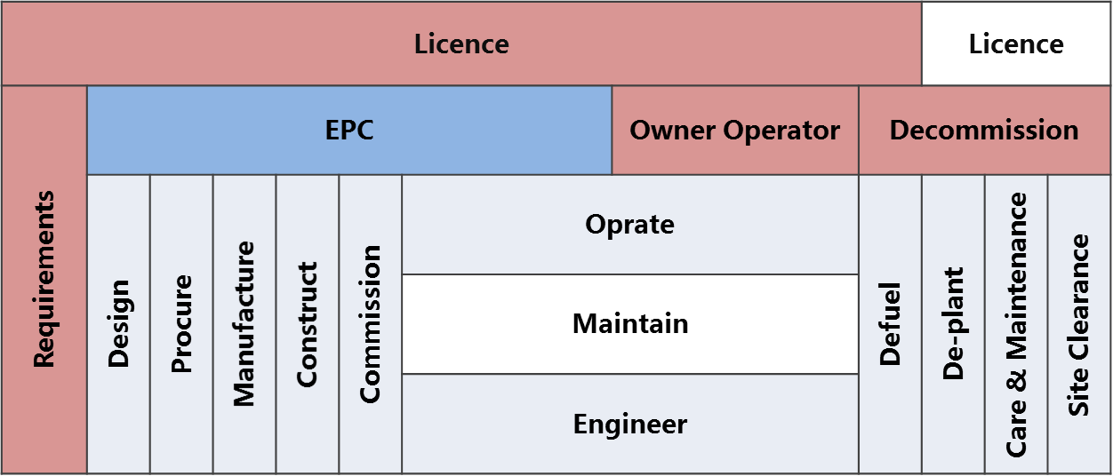
Lifecycle Responsibility model

Slide 3
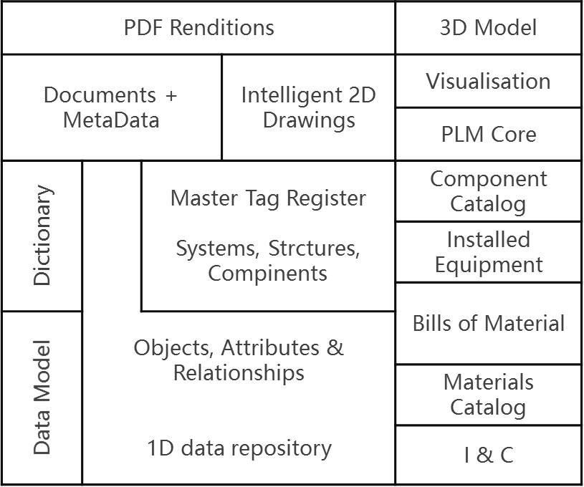
NPP Virtual Power Plant
Design Knowledge
Construction Knowledge
Procurement Knowledge
Manufacturing Knowledge
Commissioning Knowledge
Operational Knowledge
Decommissioning Knowledge

